Slide 1


Impact of Car Features on Price and Profitability

Slide 2


Today's agenda
Project Description
Data Analytics Tasks:
Dashboards
Insights
Tech Used & Approach

Slide 3

The automotive industry is undergoing rapid transformation, with a shift towards fuel efficiency, environmental sustainability, and technological innovation. As a Data Analyst, our goal is to help a car manufacturer maximize profitability while meeting consumer demand.
We will analyze a comprehensive dataset encompassing car features, market categories, and pricing. Our analysis will focus on understanding the factors that drive consumer demand and profitability. We will employ data analysis techniques, including regression analysis and market segmentation
Project Description

Slide 4
Data Analytics Tasks:
How does the popularity of a car model vary across different market categories?
1
What is the relationship between a car's engine power and its price?
2
Which car features are most important in determining a car's price?
3
How does the average price of a car vary across different manufacturers?
4
What is the relationship between fuel efficiency and the number of cylinders in a car's engine?
5

Slide 5
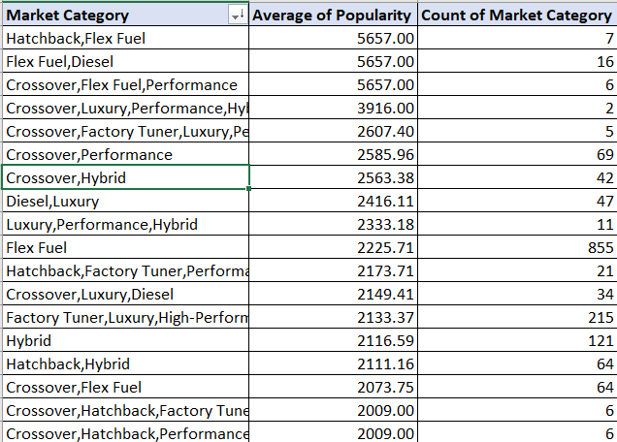
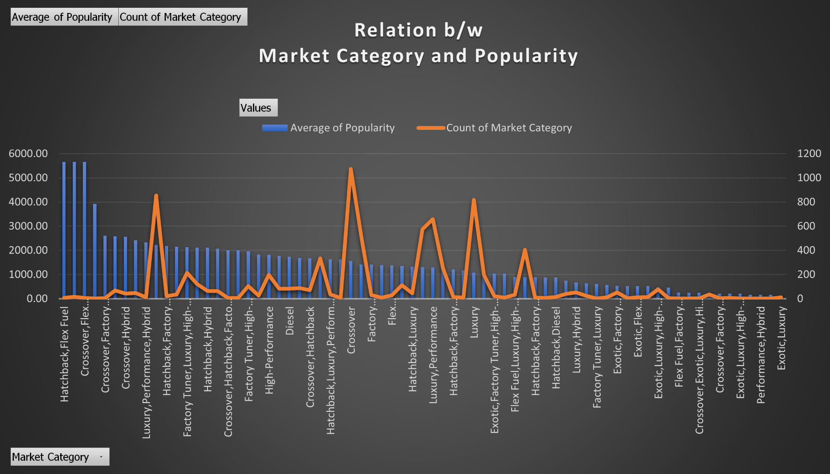
How does the popularity of a car model vary across different market categories?
Result:-
Based on the analysis of the data, it has been identified that the following car categories have the highest popularity among consumers:- “Hatchback, Flex Fuel” “Flex Fuel,Diesel Crossover”, ”Flex Fuel, Performance”.

Slide 6
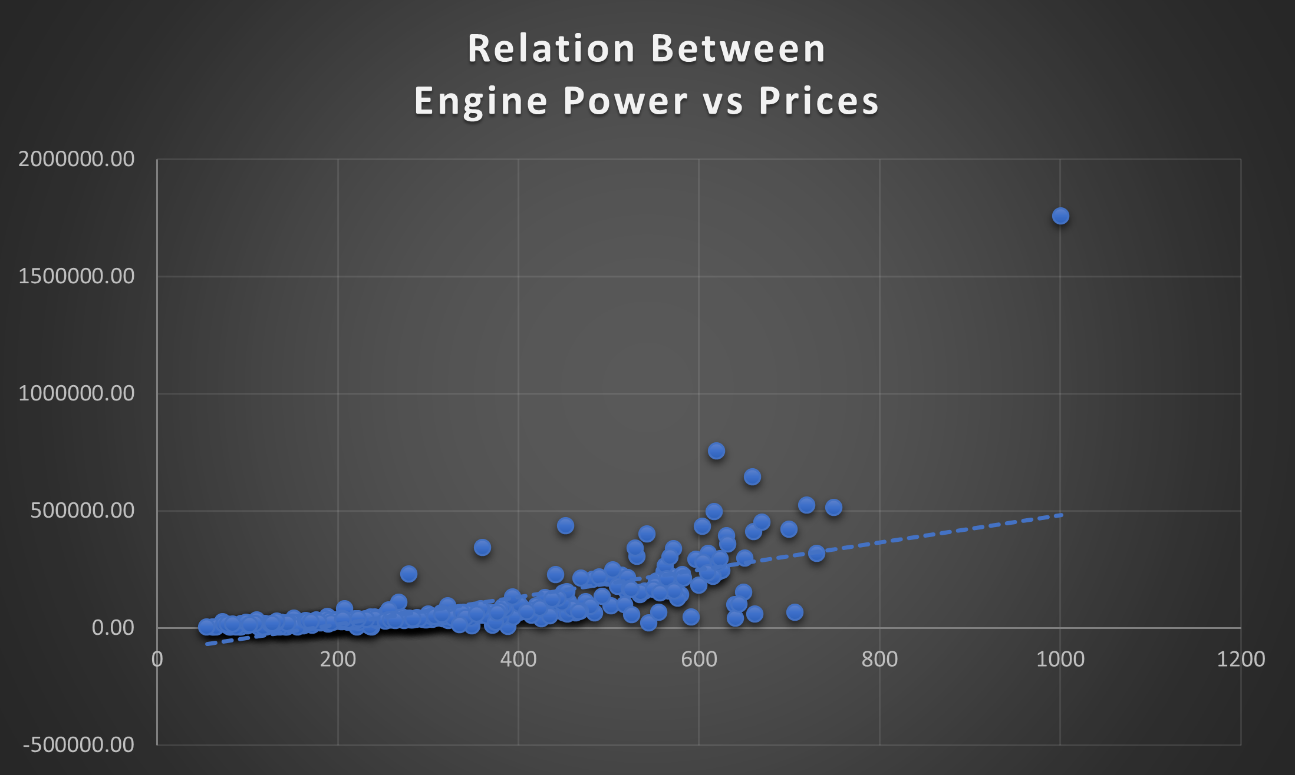
What is the relationship between a car's engine power and its price?
Result:-
The analysis indicates a positive correlation between a car's horsepower (HP) and its price, implying that higher HP leads to higher prices in the market.

Slide 7
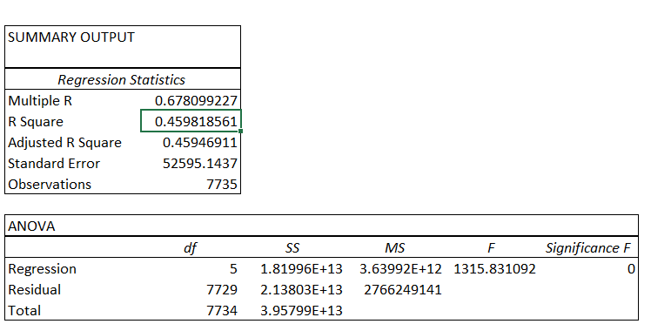
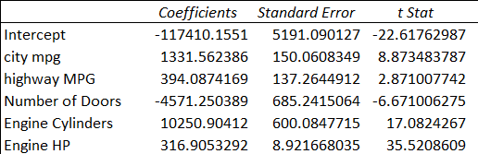
Which car features are most important in determining a car's price?
After doing the regression analysis on the data we found the above result.

Slide 8
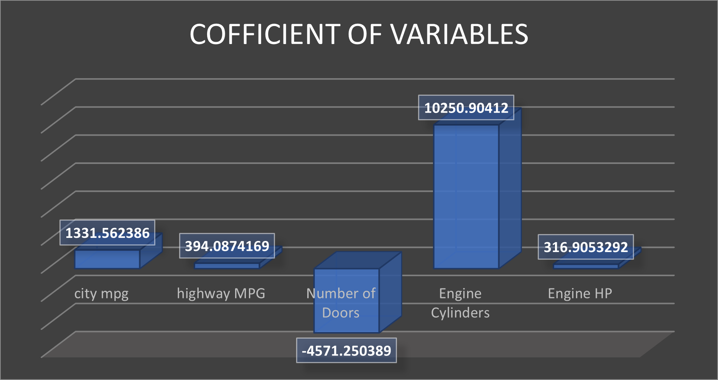
Which car features are most important in determining a car's price?
Result:-
The regression analysis findings reveal that the number of cylinders in the engine has the most significant impact on a car's price, followed by mileage and then horsepower. This insight can guide the car manufacturer in prioritizing these factors when setting prices and developing future models.

Slide 9
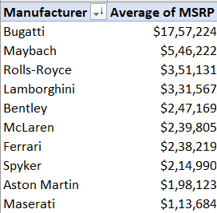
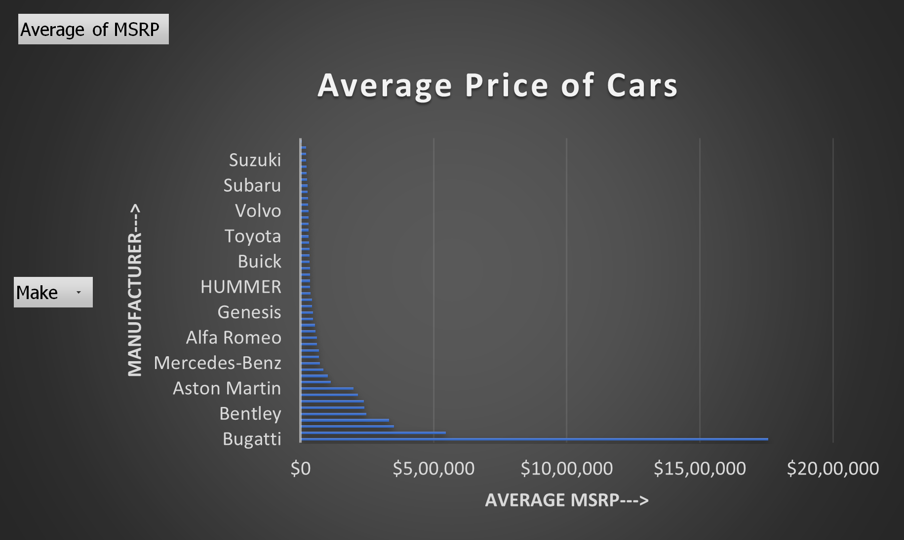
How does the average price of a car vary across different manufacturers?
Result:-
Based on the analysis of manufacturers and their average selling rates for cars, it has been determined that Bugatti has the highest average selling rate, followed by Maybach and Rolls-Royce in descending order.

Slide 10
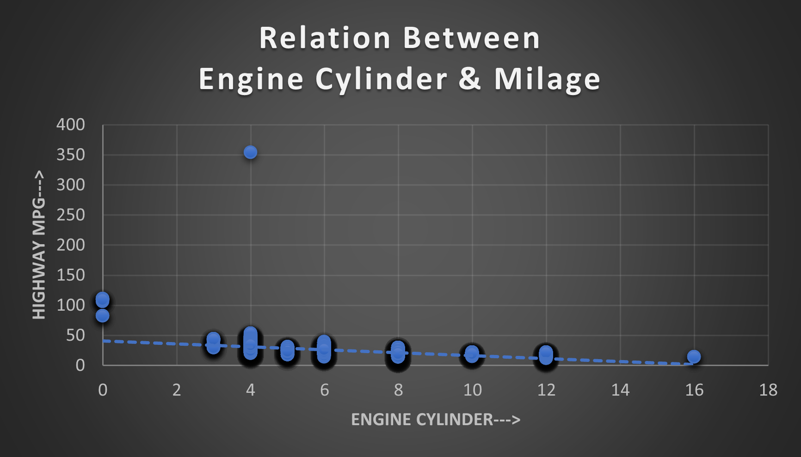
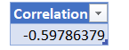
What is the relationship between fuel efficiency and the number of cylinders in a car's engine?
Result:-
Analysis reveals a negative correlation between fuel efficiency and the number of engine cylinders, indicating that as cylinder count increases, efficiency decreases. The calculated correlation coefficient supports this inverse relationship, offering insights for engine design decisions.

Slide 11
Dashboards:-
How does the distribution of car prices vary by brand and body style?
1
Which car brands have the highest and lowest average MSRPs, and how does this vary by body style?
2
How do the different feature such as transmission type affect the MSRP, and how does this vary by body style?
3
How does the fuel efficiency of cars vary across different body styles and model years?
4
How does the car's horsepower, MPG, and price vary across different Brands?
5

Slide 12
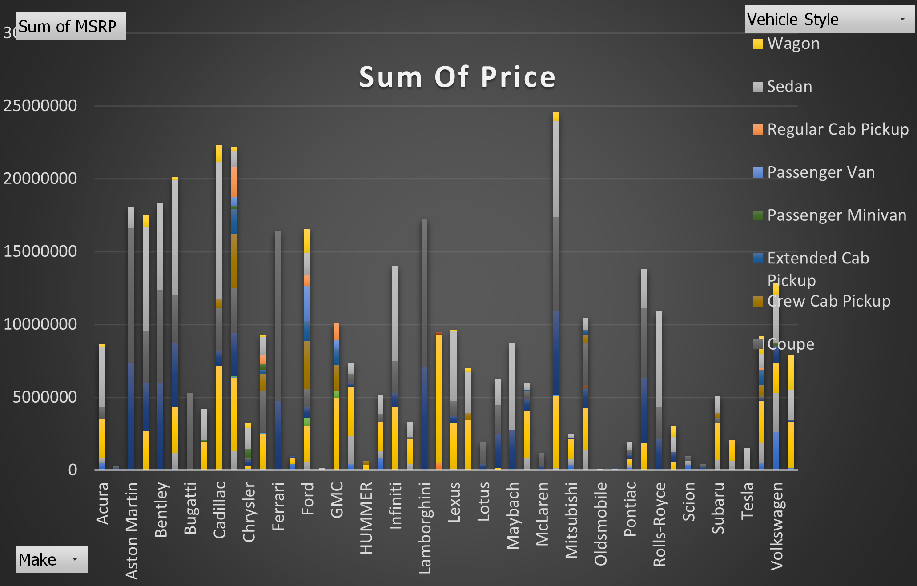
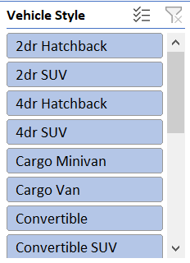
How does the distribution of car prices vary by brand and body style?
Result:-
Following the data analysis, it was determined that Chevrolet has the highest price distribution among the car manufacturers in the dataset.

Slide 13
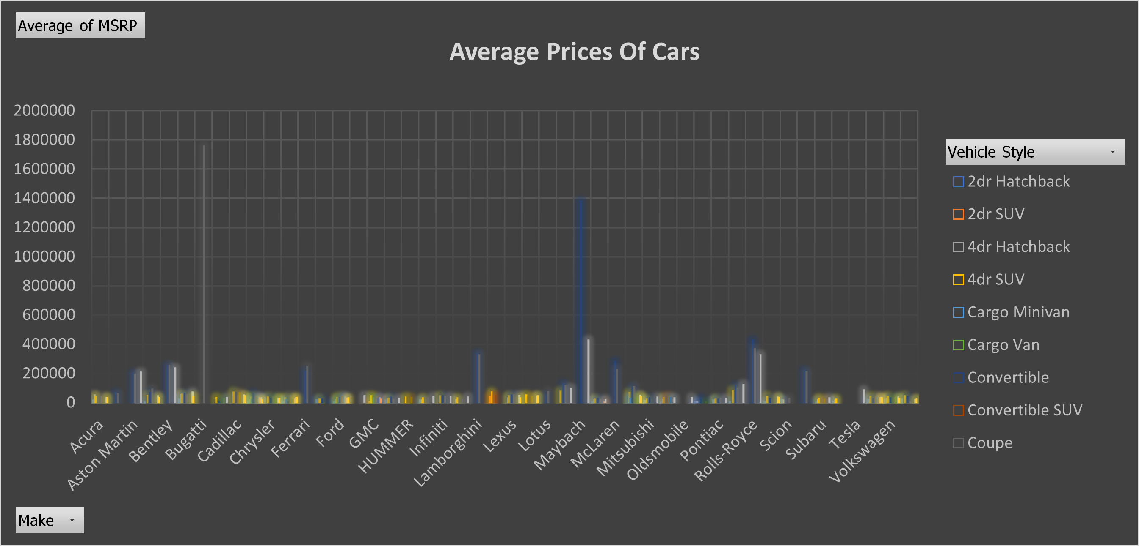
Which car brands have the highest and lowest average MSRPs, and how does this vary by body style?
Result:-
Upon analyzing the data, it was found that Bugatti has the highest average Manufacturer's Suggested Retail Price (MSRP), while Plymouth has the lowest average MSRP among the car manufacturers in the dataset.

Slide 14
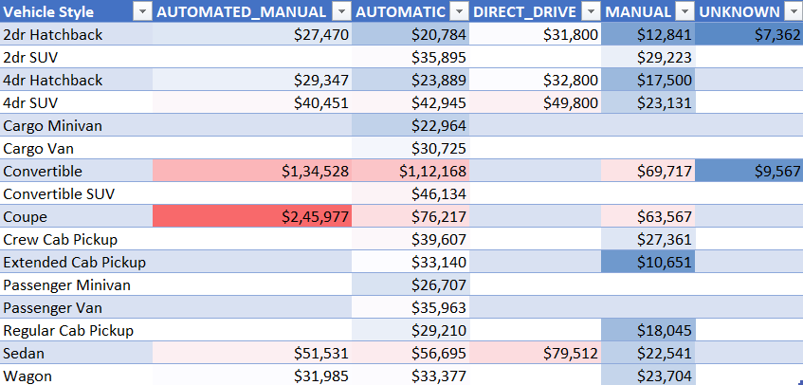
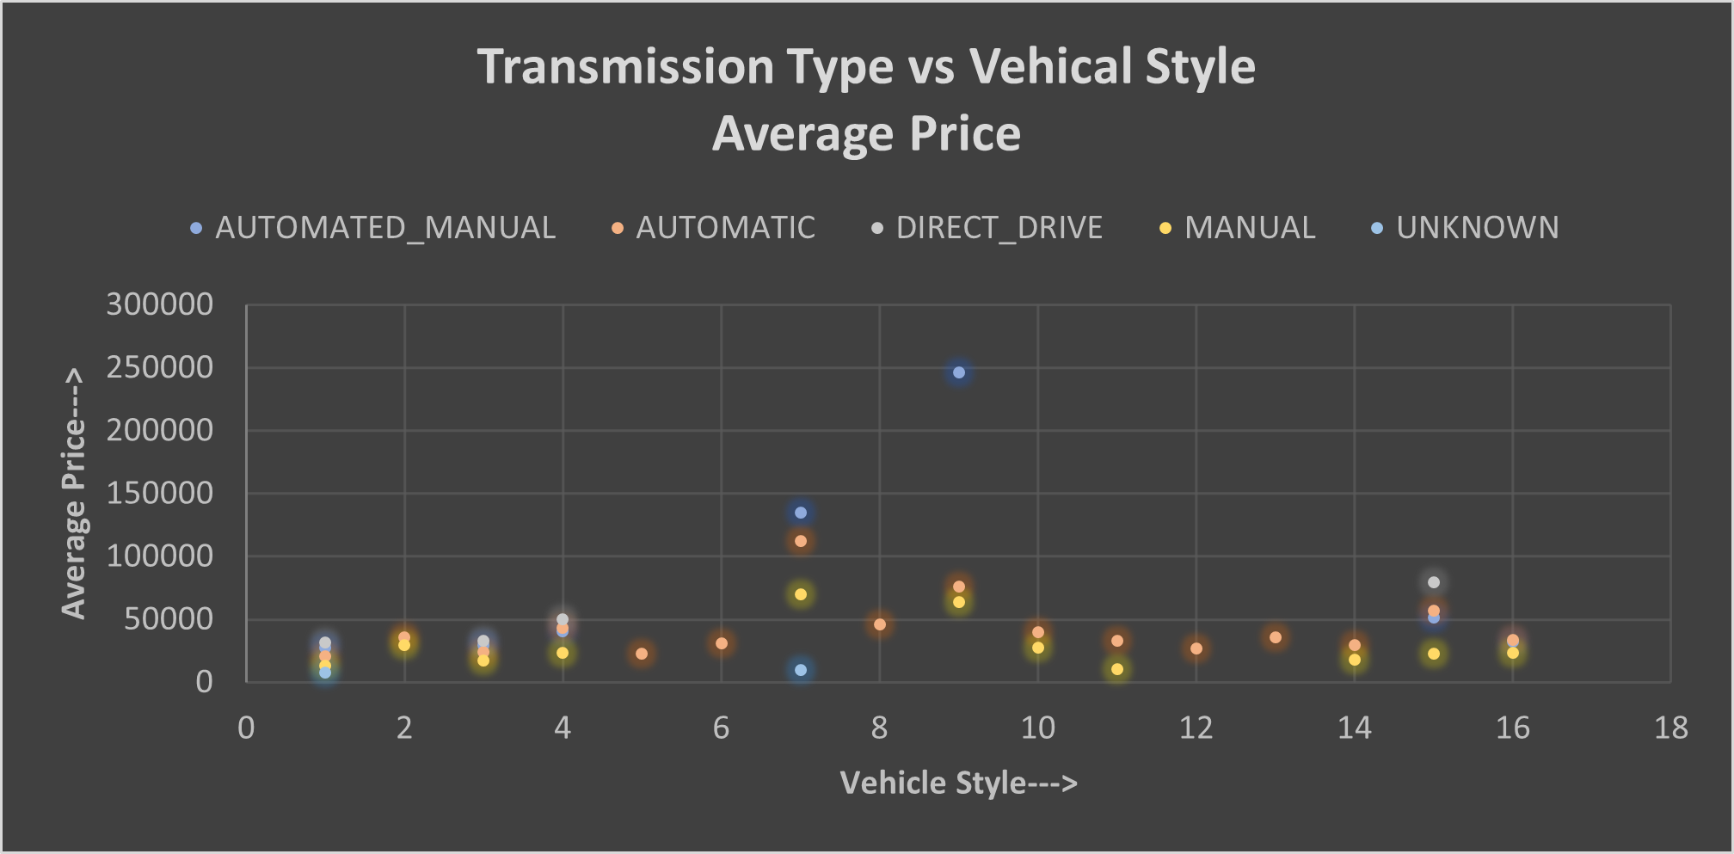
How do the different feature such as transmission type affect the MSRP, and how does this vary by body style?
Result:-
After analyzing the data, it became evident that among all transmission types, automated manual transmissions, particularly in the coupe style, have the highest MSRP (Manufacturer's Suggested Retail Price). Conversely, manual transmissions tend to have the lowest MSRP on average.

Slide 15
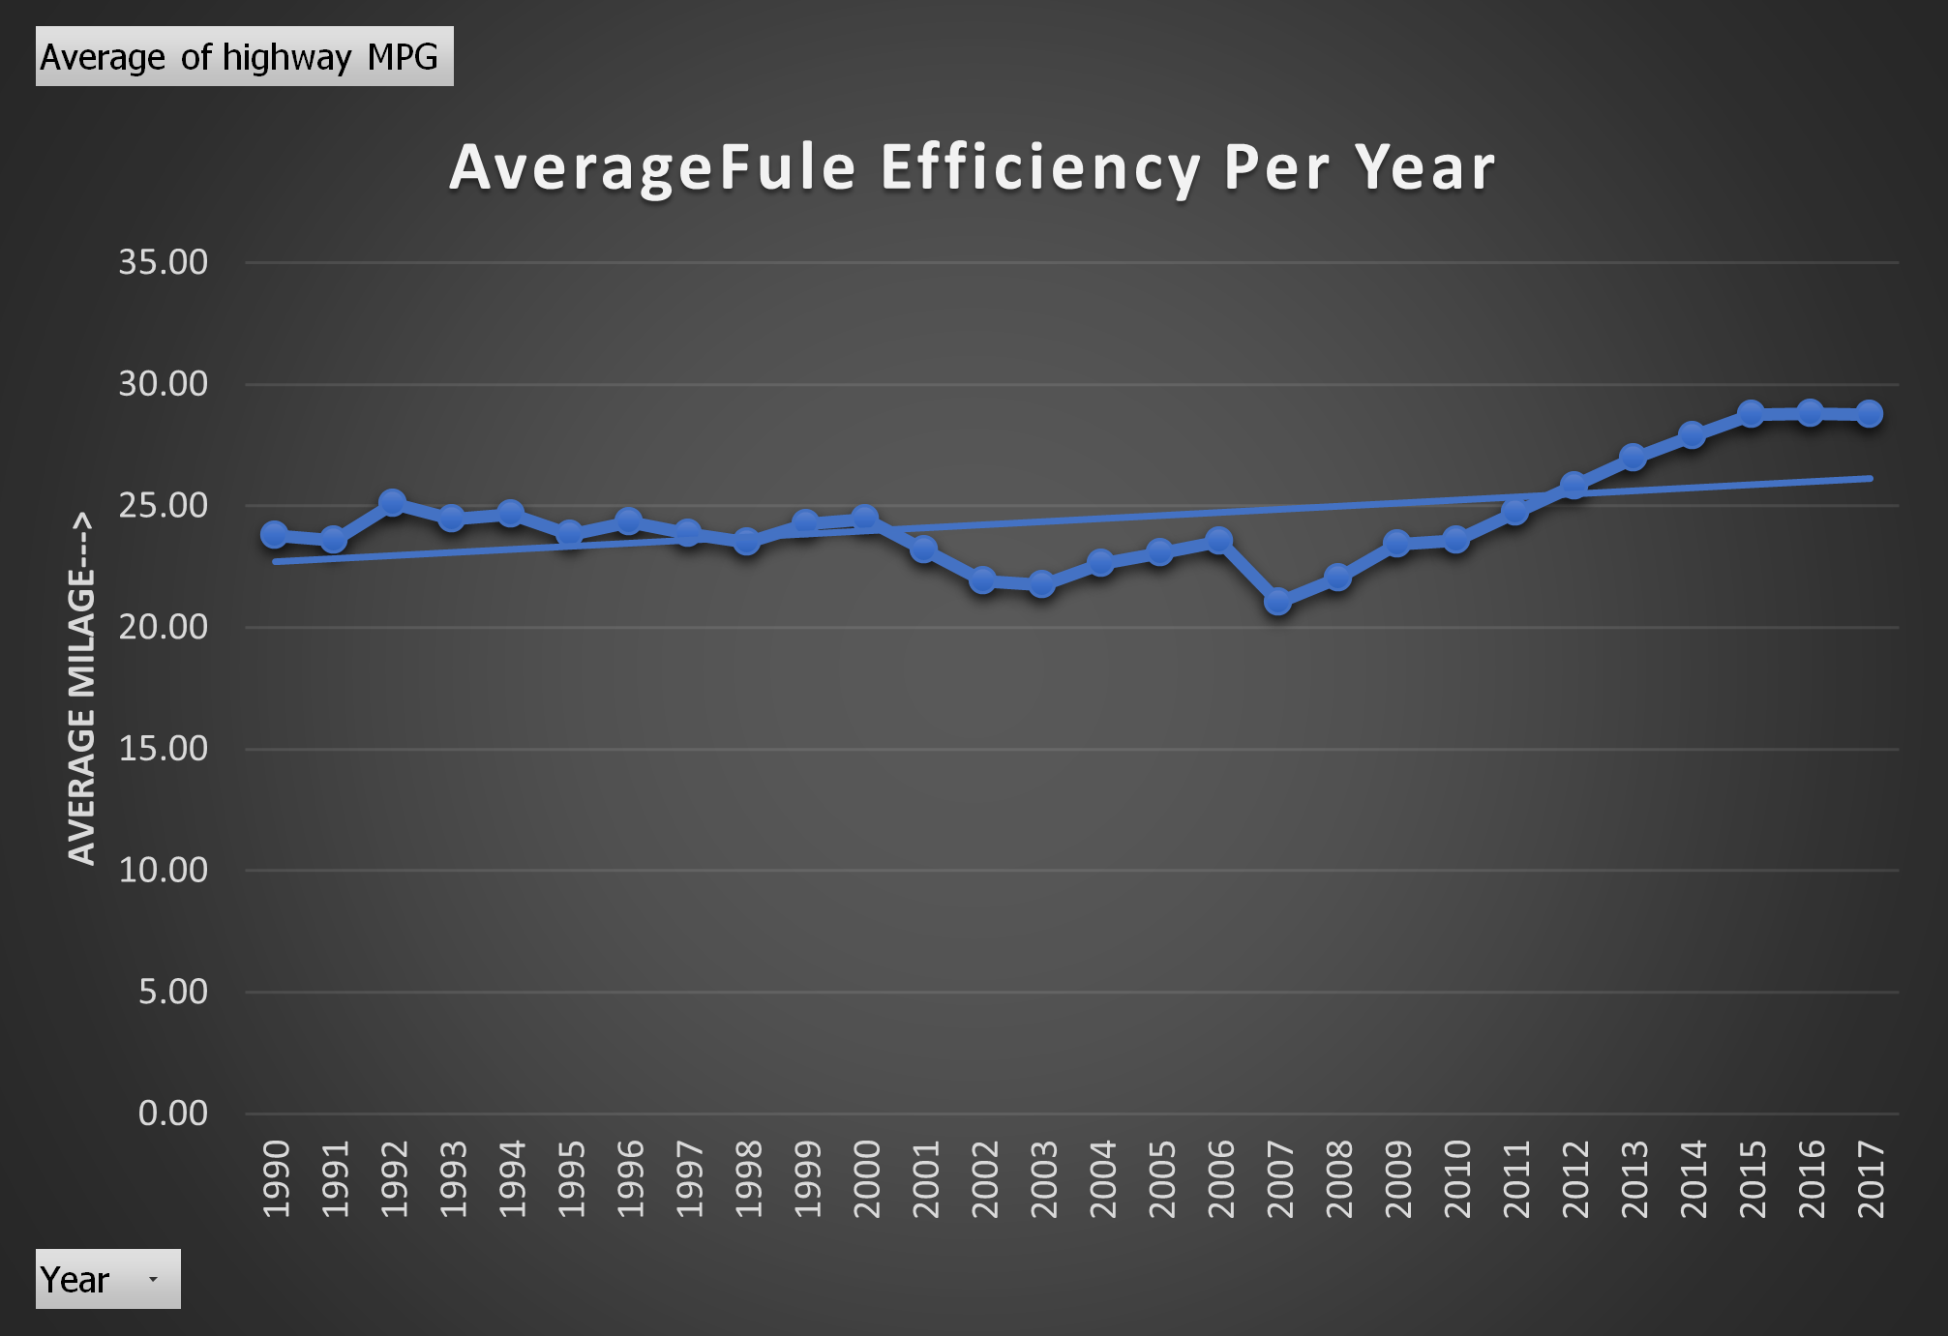
How does the fuel efficiency of cars vary across different body styles and model years?
Result:-
The analysis and chart demonstrate a direct relationship: as the model year increases, fuel efficiency rises. This trend is unmistakably illustrated by the upward-sloping trendline on the chart.

Slide 16
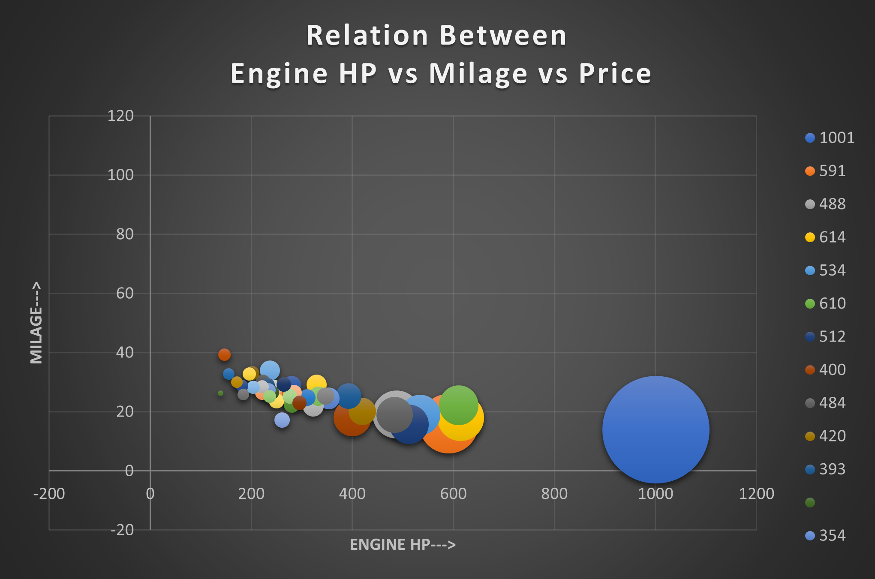
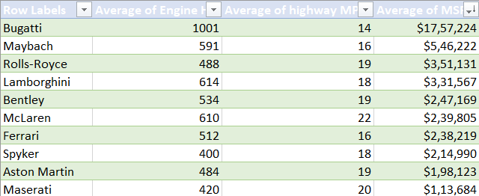
How does the car's horsepower, MPG, and price vary across different Brands?
Result:-
Following data analysis, it's evident that as engine horsepower (HP) increases, mileage decreases, and prices tend to rise, indicating an inverse relationship between HP and mileage, as well as a positive relationship between HP and price.

Slide 17
Insights
After data analysis, it's clear that Hatchback, Flex Fuel is the most popular category, and it's notable that market categories featuring Flex Fuel tend to have high popularity among consumers.
The engine with the highest horsepower (HP) at 1001 is associated with an average MSRP of $1,757,224.
Vehicles with manual transmission are typically cheaper than those with automated manual transmission systems.
Bugatti's MSRP is the highest compared to other car makers, reflecting its premium positioning in the market.
There appears to be an outlier in the data where a 4-cylinder engine achieves the highest highway MPG of 354, which is unusually high compared to other data points.
Data sheet:-

Slide 18
Tech Used:-
Excel by Microsoft Corporation – For extracting & manipulating data
PowerPoint by Microsoft Corporation – For creating the project report.
Approach:-
Our initial approach involves comprehensively understanding the dataset, including its structure, data types, and available information. Following this, we will undertake a data cleaning process to rectify any blank spaces resulting from human or system errors, as well as address inconsistent values. Subsequently, we will proceed to analyze the refined data, extracting the necessary insights. Finally, we will compile these insights into a professional and presentable report, ensuring effective communication of our findings.

Slide 19

Thank you!
ANY QUESTIONS?

